Slide 1

Briefing Book for VWFSC Internal Communication Retainer 2022
November, 2021

Slide 2
Background | Company Introduction
Volkswagen Financial Services are a business division of the Volkswagen AG group of companies and comprise Volkswagen Financial Services AG along with its associated companies, Volkswagen Bank GmbH, Porsche Financial Services, and the financial services companies in the USA, Canada, and Spain that belong directly or indirectly to Volkswagen AG – with the exception of the financial services of the Scania brand and Porsche Holding Salzburg. The key business fields embrace dealer and customer financing, leasing, the bank and insurance business, fleet management and mobility offers. Volkswagen Financial Services have a total of 16,267 employees worldwide – including 7,010 alone in Germany. Volkswagen Financial Services report total assets of around EUR 207.6 billion, an operating result of EUR 2.6 billion euros and a portfolio of around 20.3 million current contracts (as at: 31.12.2018).
Volkswagen Finance (China) Co., Ltd. and Volkswagen New Mobility Services Investment Co., Ltd (Volkswagen Financial Services China) are both wholly-owned subsidiaries of Volkswagen Financial Services AG. Volkswagen Finance (China) Co., Ltd.is the first wholly foreign-owned professional automobile financial service company in China, established in 2004. VWFS China currently has more than 900 employees nationwide. Volkswagen Financial Services China established close collaboration with SAIC Volkswagen, FAW – Volkswagen and Volkswagen Group Import (China), providing innovative financial services to Volkswagen Group brands, covering Volkswagen, Audi, Skoda, Porsche, Scania, Bentley, Lamborghini and MAN. Business lines cover areas of new car and used car retail finance, wholesales finance, operational leasing, financial leasing etc.

Slide 3
Internal Communication Target
Main Category
Culture Communication
Employee Event Communication
  Further deliver FS Values, Group Essentials to employees.
  To enhance culture understanding and to gradually lead culture-driven behavior change.
  Design, plan and support implementing employee event.
  To draw employees’ attention to the event and to increase employees engagement.
Internal Communication
Internal Project Communication
RONGZHI
  Formulate creative and tailored internal project communication plan.
  To gain employees’ understanding upon the project.
  Creatively design and arrange internal magazine RONGZHI content.
  To produce useful content and interesting magazine format to employees.

Slide 4

Internal Communication Work Scope 2022
Culture Communication
Formulate and execute unique and effective communication plan for specific culture concept/program.
High quality translation on relevant content preparation.
Creative visual design and extension to further improve the understanding of corporate culture. For example, design on decoration, standees, posters, booklet, gifts, screen savers , etc.
Event planning, including shooting, camera, video production, material production and onsite support.
1
2
3
4

Slide 5

Internal Communication Work Scope 2021
Employee Event Communication (Location: VWFS Building)
Creatively design visual decoration to better fit the event theme. For example, standees, posters, KVs, etc.
Support event communication, for example, draft attractive communication letter and copy writing.
Support drafting event (e.g. HR Open day, employee interview, etc. ) plan (concept, target group, agenda, timeline, etc.)
Support event implementation (Venue arrangement, material production, AV equipment, acoustic equipment, etc. )
1
2
3
4

Slide 6

Internal Communication Work Scope 2022
Internal Project Communication
According to the project target, help formulate the project concept, slogan, promotion plans/ communication skills, etc.
Project communication material design, for example, icons, posters, standees, projects including Stiba, New Strategy communication, etc.
Internal recruitment poster design.
Share point intranet banner design/ relevant content preparation
1
2
3
4

Slide 7

Internal Communication Work Scope 2022
RONGZHI
Design: Online design and modification (Cover, Inside Pages)
High quality bilingual content proofread and editing.
Well printed magazines
1
2
3

Slide 8
Deliverables
Proposal
        Insights in Internal Communication for VWFSC
        Further and wider development in Internal Communication function
        Previous relevant successful projects
        Work plan, e.g. regular meeting, work report, monthly plan content
        Introduction of company and service team

Slide 9
Agency Requirement
Professional Internal Communication agency with expertise and rich experience in auto and auto finance industry, company culture industry, know of other related industries as well.
Creative ideas on internal communication projects.
In-depth understanding of employee’s preferences.
Stable, efficient and experienced project team with sufficient manpower and capacity.
Professional English communication skills, both verbal and written.

Slide 10
Back-Up

Slide 11




1. FS Values
Take responsibility
Customer come first
Have the courage to do what is right
Trust and empower each other
Passion to perform
Notes:
Neue Bilder kommen von Anika bis spät. Freitag!

Slide 12







The Group Essentials are the Group’s value foundation that
unites all brands and subsidiaries within the Group.

Slide 13
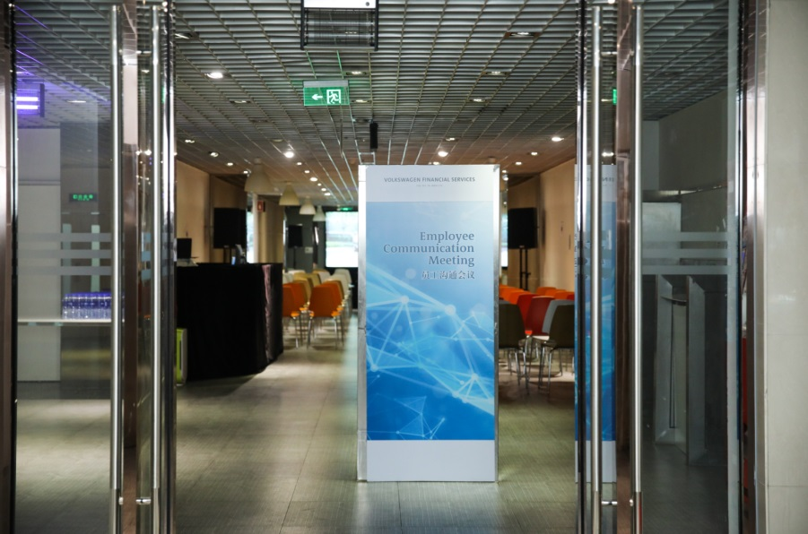
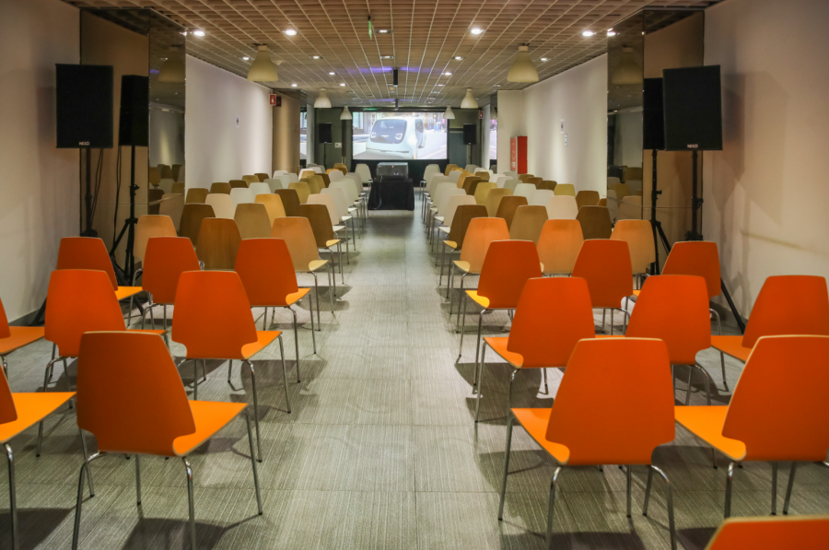
3. Previous Employee Event in Company (Town hall meeting)
Basic Information
Location: VWFS China Building Canteen
Requirement
Design: KV, posters, etc.
Construction: screen, acoustics equipment, control desk, microphone, etc.
Arrangement: tables, chairs, KT board, etc.
Staff Support: AV adviser, activity coordinator

Slide 14

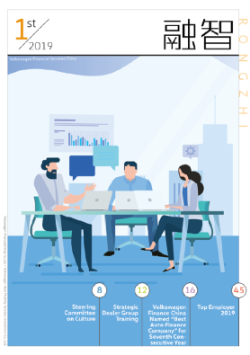


4. What Is RONGZHI 《融智》?
Why We Issued RONGZHI ?
What Is RONGZHI ?
RONGZHI is the only internal magazine of VWFS China, issued quarterly.
Online (shared on SharePoint (Intranet)) and printed version are both provided
Content included:
Latest news of auto finance industry, company, departments (News will be collected by us)
Employee info and Pet Show
Info Sharing and News Updated
Cross-departmental Understanding
Corporate Culture Tool

